Slide 1
Introduction to Social Media Analytics (Lec 8)
Hao PENG
Department of Data Science
City University of Hong Kong
https://haoopeng.github.io/

Slide 2
Agenda for this week
Engagement analysis & prediction
Macro-level user studies
Individual & collective behavior
adoption, retention, churn prediction
Community, polarization
Echo Chambers
Power of diverse / polarized teams
Personalization & Recommendation

Slide 3
Action analytics
Social media actions analytics deals with extraction, analysis, and interpretation of insights contained in actions performed by social media users.
Actions on SM are easy and fast way to express feelings, unlike written reaction. They can be considered as social expressions and symbolic reactions to social media content.
Actions are the cash cow/flow of social media companies.
Can be used to measure popularity and influence (not quality) of a product, service, or idea on social media.

Slide 4
Common social media actions
Like buttons
Dislike
Share
Visitors, Visits, Revisits
Views
Clicks
Tagging
Mentions
Hovering
Check-in
Pinning
Embeds
Endorsement
Downloading
Notes:
Endorsement is a features of social media that lets people endorse and approve other people, products, and services.

Slide 5
Common social media actions
Mentions
Mentions or social mentions are the occurrence of a person, place, or thing over social media by name.
Mentions indicate popularity of person, product, place.
Check-in
Check-in is a feature that allows users to announce and share their arrival at a location, such as a city, hotel.
Rich check-in data can be mined to offer location-based services and products.

Slide 6
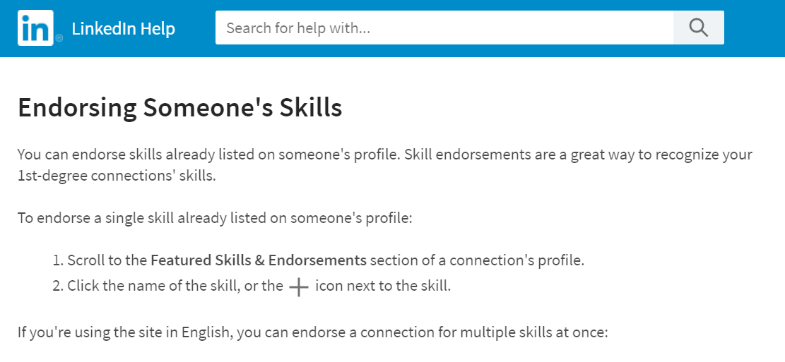
Common social media actions
Endorsement
Endorsement is a features that lets people to endorse, rate, and approve other people, products, and services.
Common types of endorsement: product reviews

Slide 7
Common social media actions
Tagging
Tagging is the act of assigning or linking extra pieces of information to social media content for identification, classification, and search purposes.
Pinning
Pinning is an action performed by social media users to pin and share interesting content (such as product, idea, services, and information) using a virtual pin-board.

Slide 8
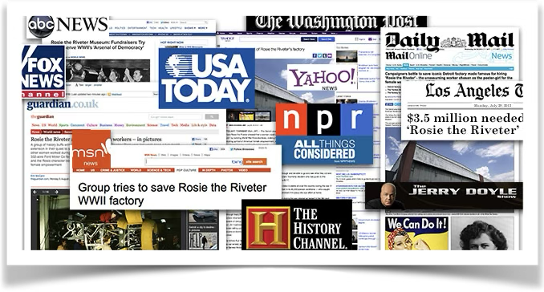
Case: predicting papers’ news coverage
Media coverage is one of the most important alternative metrics (besides traditional metrics such as citations) for measuring the popularity of academic papers.

Slide 9
Case: predicting papers’ news coverage
Media coverage is one of the most important alternative metrics (besides traditional metrics such as citations) for measuring the popularity of academic papers.
Both metrics are field-dependent (e.g., math < biomedical).
Both metrics only partly reflect (not equal to) quality/merits.
Timing difference: citation counts are often delayed (sleeping beauty effect), whereas news often happens in a few weeks.
Audience difference: papers are mostly cited by academics, whereas news reports are often consumed by the public.
Relative to citations, news coverage is much less understood.

Slide 10
Case: predicting papers’ news coverage
Motivation & significance
Media reports amplify a paper’s impact beyond the academy & disseminate the latest breakthroughs & findings to the public.
We know little about how linguistic features alone can affect a paper’s chance of news coverage beyond its content quality.
Understanding this question can avoid the situation where truly newsworthy papers lose their attention to less-deserving ones.
Institution reputation (e.g., Harvard vs. CityU)
Author seniority (different ranks of professor, etc.)
Journal impact, content quality, etc.
Research Q: To what degree can simple linguistic features predict news coverage above and beyond an idea’s content quality?

Slide 11
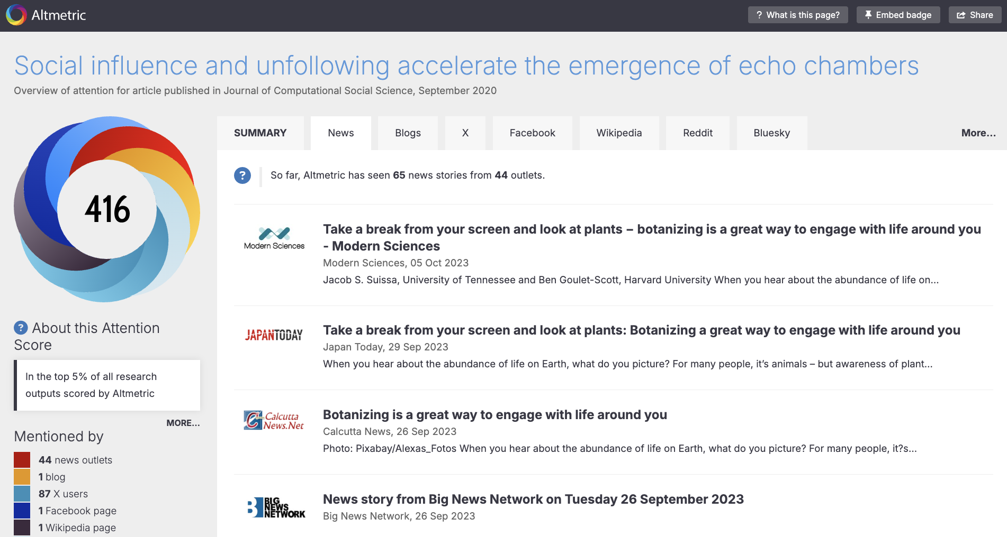
Case: predicting papers’ news coverage
Data & methods
Complete news mentions of 2.8M papers from Altmetric in 6y.
Detailed paper metadata (such as abstract) from OpenAlex.
https://www.altmetric.com/details/60364782/news

Slide 12
Case: predicting papers’ news coverage
Regression models to predict coverage:
DV1 = coverage or not (logistic regression)
DV2 = num. of news coverage (linear regression)
Key IV / predictors (computed based on the abstract):
Sentiment? Emotion?
LIWC? (such as first-person plural pronouns “WE”)
Promotional words?
Hedge words? (e.g., “high GPA may not predict future career success”)
Control variables:
Content-level factors (other linguistic variables: readability)
Author-level factors (reputation, productivity, impact, etc.)
Fixed-effects factors (year, research topics)

Slide 13
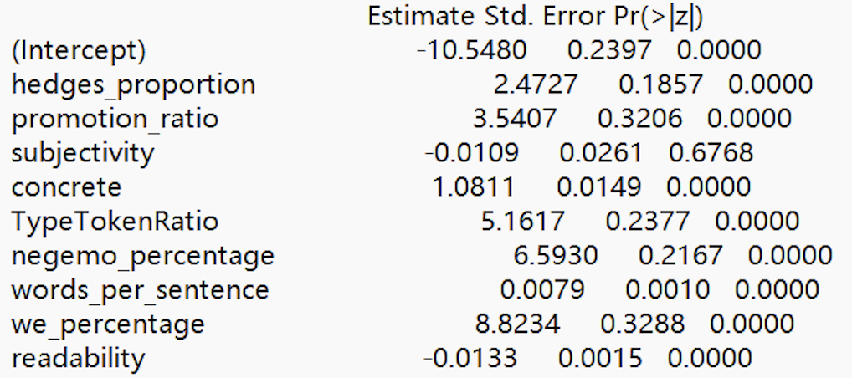
Case: predicting papers’ news coverage
Key findings & takeaways
“We” words frequency (we|us|our) predicts coverage
Negative emotion is associated with more coverage
Hype words ( e.g., “groundbreaking”) predicts coverage
Hedge words density increases likelihood of coverage

Slide 14
Case: predicting papers’ news coverage
Implications
The pen is as important as the sword: Linguistic “packaging” does affect a paper’s marketing success beyond its content.
Pay close attention to your presentation / communication style as they truly matter in today’s attention economy.
Sometimes, the quality perceived by your audience matters more than the inherent quality of your content.
Valuable lesson for content creators, marketers, influencers.
Limitations
Correlational analysis does not prove causality (recall the “brevity” paper)
Focused on English-language news outlets (effect may differ for other lang.)

Slide 15
Case: predicting papers’ news coverage
Future work
Experimentally test the causal effect of language on attention
We can tightly control for (unobservable) author/content effect
Can you give an example of unobserved factors?
What are the causal (if any) cognitive mechanisms behind the power of language in news coverage?
“We” words -> signal teamwork -> perceived credibility
Hype words, negative emotions -> capture attention (which is scarce)
Uncertain words -> adds accuracy to findings -> perceived quality
Important practice question: How can we design an experiment to (i) examine causal effect and (ii) explore cognitive mechanisms?

Slide 16
Macro-level user analysis
The study of large-scale patterns, trends, and dynamics in user behavior, interests, and communities across online platforms.
Examines aggregated data to understand individual or collective behaviors, their evolving interests, and group dynamics within populations.
It leverages big data techniques to identify trends, predict shifts, and inform strategies at a platform or societal level.
Individual user behavior: adoption/churn prediction, self-promotion, etc.
Evolution of user interests: Tracks how user interests (e.g., topics, hashtags) & behavior evolve over time, influenced by events, trends, or cultural shifts.
Community dynamics: Analyzes the formation, growth, and evolution of user communities based on shared interests, affiliations, or interactions. It examines how users cluster into groups and how these groups shift.

Slide 17
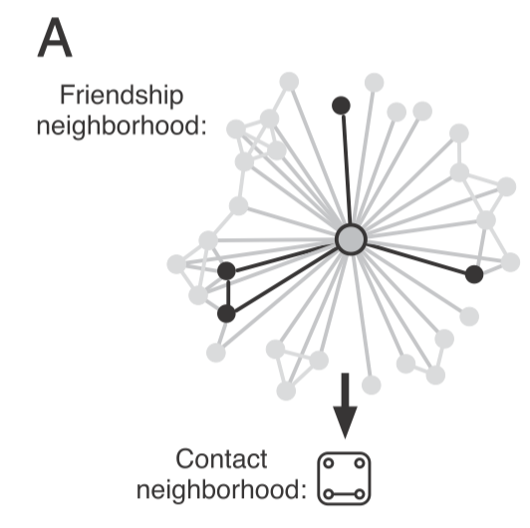
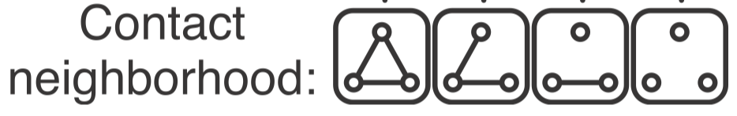

How to increase adoption on FB?
1
1
2
3
1
1
1
1
1
1
Grey links: based on email contacts of FB users (only visible to FB)
Black links: invitations sent by target’s FB friends (visible to target)
Black nodes: Num of invitations vs Num of connected components
[Which matters more?] Can you make predictions?
Notes:
(Thus, suppose that an individual A is not a user of Facebook; it is still possible to identify a set of Facebook users that A may know because these users have all imported A’s e-mail address into Facebook.)
FB knows about all the connectivity of A and FB needs to decide which invitation solicitation can maximize A’s adoption.
In this fig, among all A’s friends on FB, four of them have sent A an email invitation to join FB. In this example, A only gets to know that the four neighbors have joined FB, all other FB neighbors are hidden to A.
Talk about the other two figures.
Now the Q is does the probability of he joining FB scales linearly with num of invitations or the way how their neighbors are connected (aka structure)?
Let students predict: What if size matters more? What if structure matters more?

Slide 18
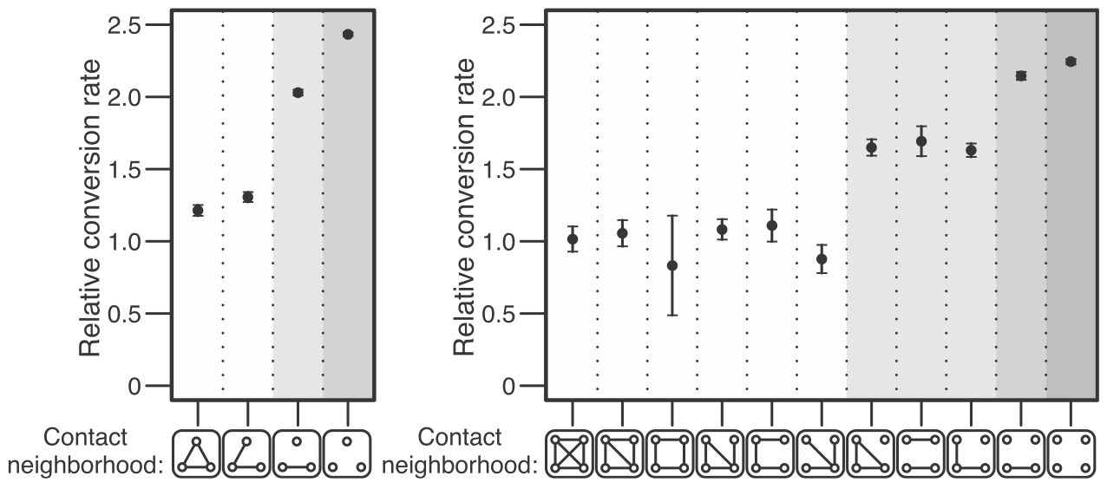
Connectivity diversity > network size
Network structure of how one’s neighbors are connected predicts the adoption rate more accurately than the size of neighbors.
Ugander et al. "Structural diversity in social contagion." PNAS 2012.

Slide 19
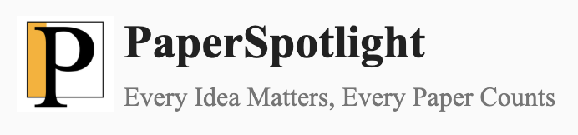
Case study: scholarly self-promotion
Motivation & Significance
Enhances research visibility: Social media platforms can amplify the reach of academic work, making it accessible to the broader audiences beyond traditional academic circles.
Builds professional networks: Self-promotion on social media can facilitate collaborations with peers and institutions.
Influences funding & visibility: Online presence can attract grants and recognition by showcasing impact to stakeholders.
Scholarly marketing companies can reach potential customers by identifying scholars who are interested in boosting visibility.
E.g. https://paperspotlight.com

Slide 20
Case study: scholarly self-promotion
Research Questions
How often do scientists involve in self-promotion?
Does it vary by year, discipline, and author impact?
Authorship position (first, middle, last author)
Author career stage (num. of publications)
Journal prestige and institution reputation
Are there gender differences in self-promotion?
Difference in self-promotion rates?
Gap in engagement with self-promotion?
Why is the gender gap important for us to understand?

Slide 21
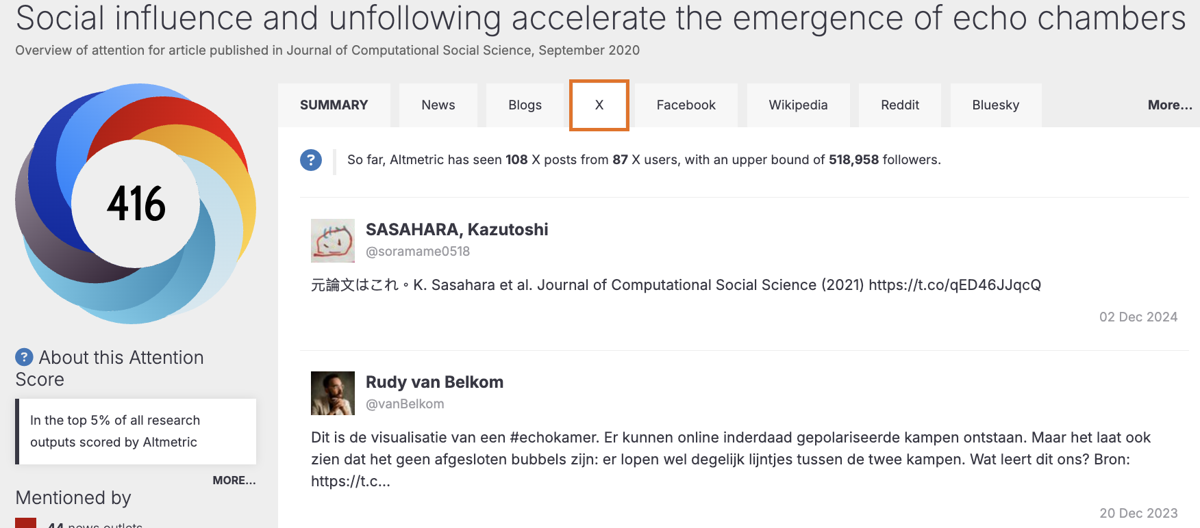
Case study: scholarly self-promotion
Data & methods
Complete Twitter mentions of 2.8M papers from Altmetric.
Detailed paper metadata (such as authors) from OpenAlex.
https://www.altmetric.com/details/60364782/twitter

Slide 22
Case study: scholarly self-promotion
Data & methods
How to detect if an author self-promoted their paper?
Token-matching: ﬁrst or last name should be matched to the tokens of tweet names (split by space or underscore).
Containment-matching: only if the tweet names are single-token strings and the ﬁrst/last name has >= four characters.
How to predict author gender?
Should we use self-identities or inferred ones?
How to estimate error rates for name-based classifiers?
Does the error rate differ by ethnicity?
How to use regressions to examine the gender gap?
DV, IV, Controls
Notes:
Agreement with manually verified gender labels
Validation with self-reported gender labels

Slide 23
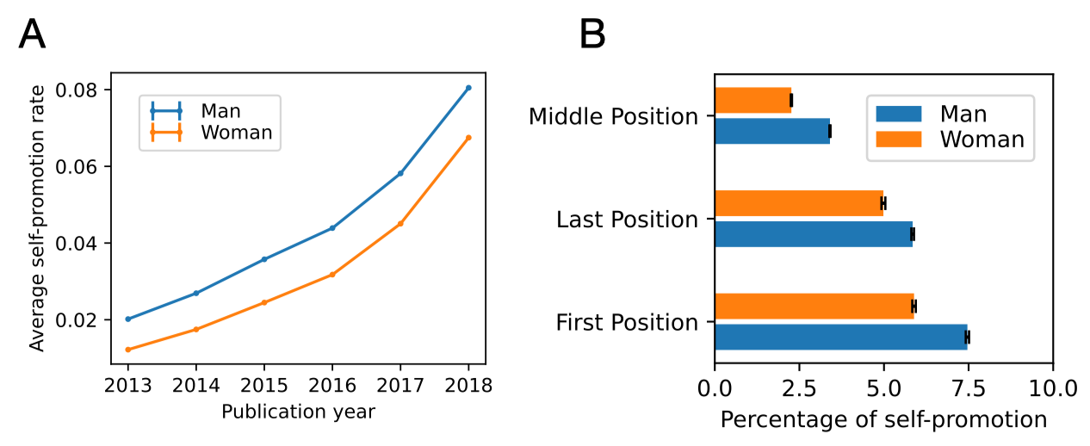
Case study: scholarly self-promotion
Key findings (raw differences w/o. any control)
The increasing gender gap in (exploded) self-promotion rates
Consistent gaps across different author roles and disciplines.
Peng et al. The Gender Gap in Scholarly Self-Promotion on Social Media. Nat. Commun. 2025.

Slide 24
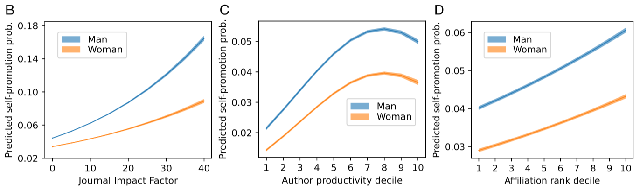
Case study: scholarly self-promotion
Key findings (gender gaps adjusted for confounds)
Gap increases with higher performance and achievements.
Larger gender gaps for women with higher academic status.
Peng et al. The Gender Gap in Scholarly Self-Promotion on Social Media. Nat. Commun. 2025.

Slide 25
Case study: scholarly self-promotion
Are there differential return by gender with self-promotion?
DV: predicting a paper’s total num. of tweets:
Y = β₀ + β₁ women + β₂ promotion + β₃ (women・promotion) + Σ
Rewrite the equation as:
Y = β₀ + β₁ women + (β₂ + β₃ women) promotion + Σ
How do we interpret β₃?
Equation for men: Y = β₀ + β₂ promotion + Σ
Increase in Y if men self-promotes: β₂
Equation for women: Y = β₀ + β₁ + (β₂ + β₃) promotion + Σ
Increase in Y if women self-promotes: β₂ + β₃
β₃: Women’s return on self-promotion relative to men’s

Slide 26
Case study: scholarly self-promotion
Key findings (differential “return” by gender)
Self-promotion increases engagement for both genders.
But the boost for women is smaller than men’s boost.

Slide 27
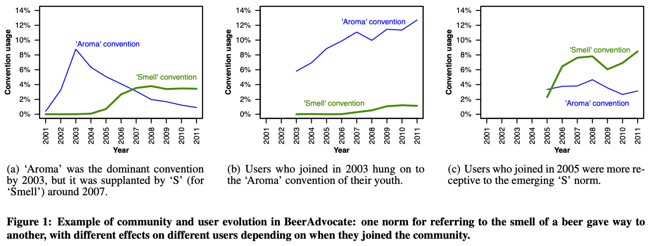
Churn prediction using linguistic change
There are linguistic norms in online communities, which is evolving.
New users often adapt to current norms upon joining a community.
As they get older, they become “lazy” to sync with new norms/rules.
Cristian et al. User lifecycle & linguistic change in online communities. WWW. 2013.

Slide 28
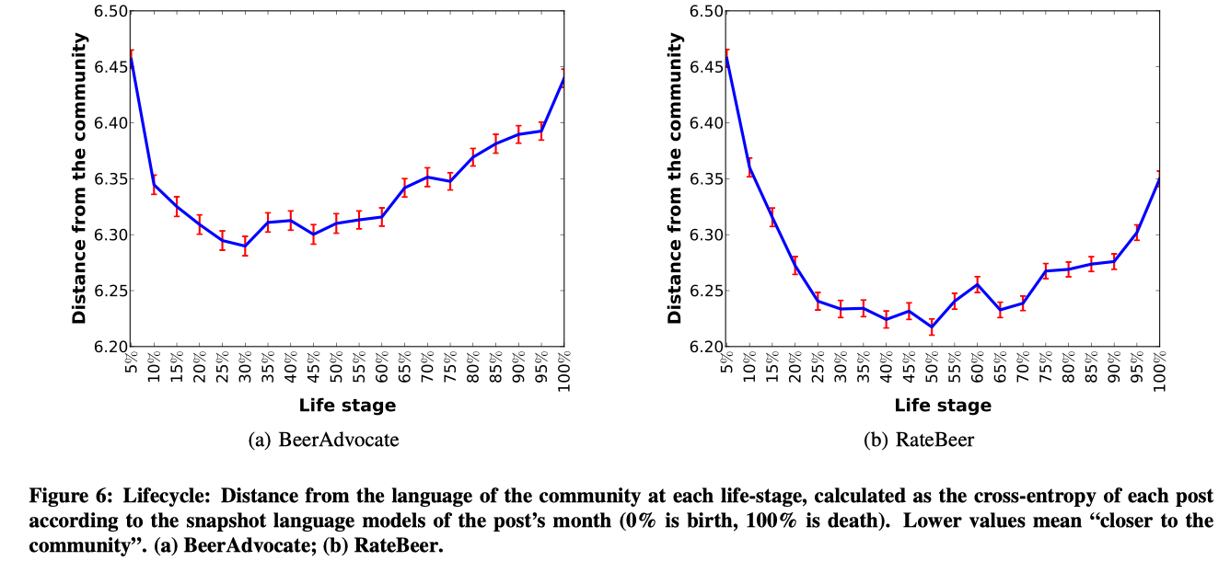
Churn prediction using linguistic change
A two-stage lifecycle of user susceptibility to linguistic norm change:
Learning phase (1/3): users learn community’s innovative language
Conservative phase (2/3): users stop tuning with evolving norms
Notes:
Linguistic norms are always changing in online communities
Users leave when old conventions conflict with new norms

Slide 29
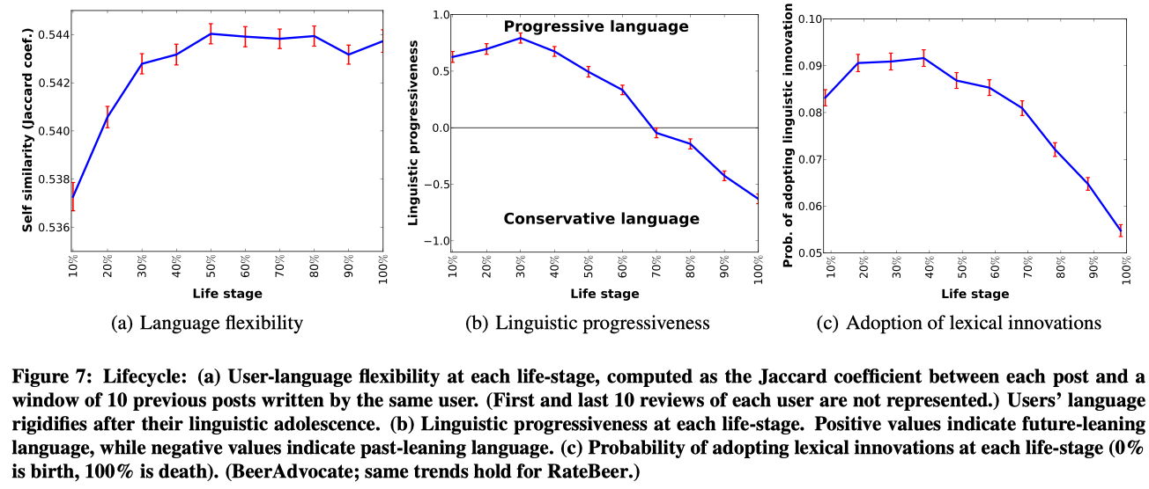
Churn prediction using linguistic change
Adolescent users learn and adapt to new and progressive language.
Senior users stop conforming and drift away from latest trends.
Can we leverage these patterns/features to predict user retention?
Notes:
Compare the target post to all posts during 2y period (one year before and one year after) by computing H(p,SLM i ), the cross-entropy of p with respect to the SLM i language model.
Under this notation, Prog(p) = −3 would mean that the language of the post p appears to closest to the language used in the third month before p was written.
A lexical innovation is a word that was never used before in the community and that was used at least 10 times by multiple users in posts discussing different products over a period of 6 months after the word was ﬁrst used.

Slide 30
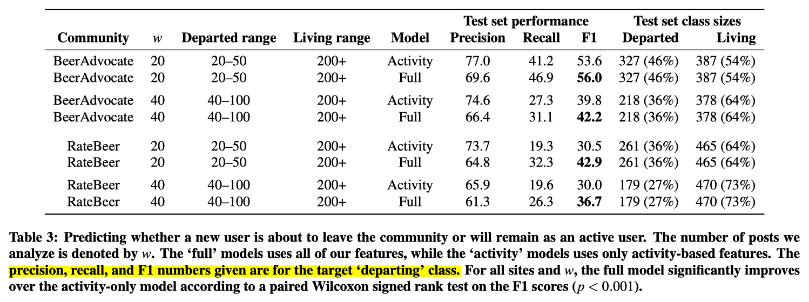
Churn prediction using linguistic change
Using first w posts to predict (logit model) churn or retention:
Departed: users who left before writing m more posts (e.g. [20, 20+30])
Stayed: users who stayed long enough to write >= 200 posts in total
Notes:
The task ignores middle users in the range [50, 200] because their staying status is uncertain.

Slide 31
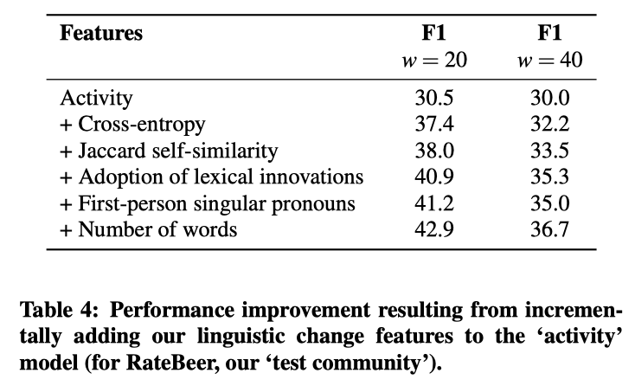
Churn prediction using linguistic change
Churn prediction is a hard problem (baseline F1 = 0.3)
Linguistic features can improve performance by ~40%!

Slide 32

Success of online communities

Slide 33
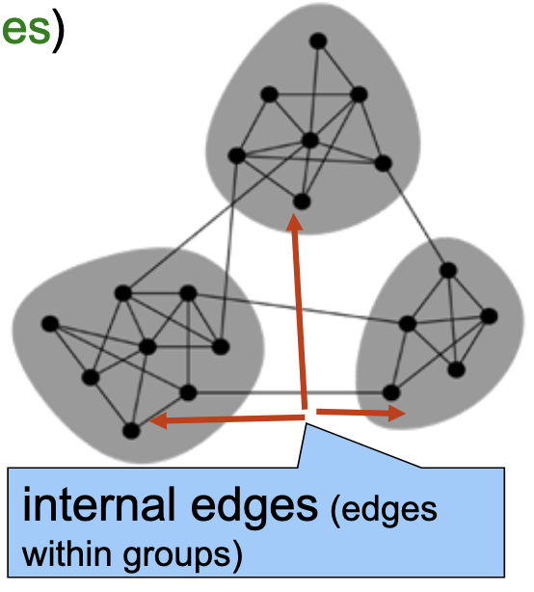
Polarization on social media
Key polarization metrics
Structure based:
Network modularity Q: the fraction of all edges that fall within communities minus the expected fraction if edges were distributed at random.
Edge density ratio: num. of edges (within / between)
Opinion based:
Opinion variance among group members
Ideological preference
Sentiment score
Can use Std. or Gini index

Slide 34
Echo chambers
Echo chamber in social media refers to an environment where users are primarily exposed to content, opinions, and information that align with their existing beliefs.
How it forms:
Algorithms prioritizing content with high engagement
User behavior: people tend to follow, friend, and join groups with like-minded individuals (homophily).
Network effects: online communities (e.g., subreddits) amplify shared narratives due to social influence.

Slide 35

Echo chambers
How to break out of Echo Chambers:
Diversify your feed: Follow credible accounts with opposing views (e.g., @nytimes and @foxnews).
Use platform tools: Turn off personalized recommendations.
Seek primary sources: Read original studies instead of opinion posts. Make own judgement with critical thinking.
An D3 interactive visualization of the formation of Echo Chambers:

Slide 36
Power of polarized teams
Dataset
English Wikipedia database: focused on articles in 3 categories: politics (20,947 articles), social issues (162,085), science (49,530).
Represents about 5% of all English Wikipedia articles.
Methods
Measure editor’s ideological preference:
Difference in the fraction of bytes/words they contribute to conservative vs. liberal Wikipedia articles (based on a given corpus); [-1, +1].
Measure each article’s quality:
Use the Wikiclass package to predict one of six quality categories
https://pypi.org/project/wikiclass/
Measure team polarization of each article:
Compute the variance of alignments among all its editors

Slide 37
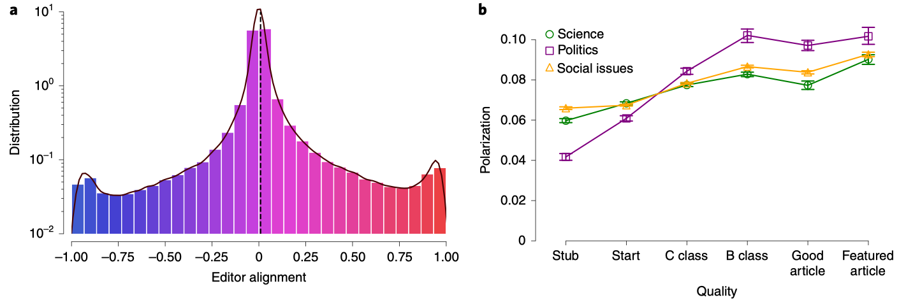
Power of polarized teams
Center peak: most editors only contributed minor edits (typos)
Two tail peaks: some editors have contributed much content to either liberal or conservative articles.
Fig b: What factors can confound the link btw. Polz. and Quality?
Shi et al. The wisdom of polarized crowds. Nat. Human Behaviour. 2019.

Slide 38
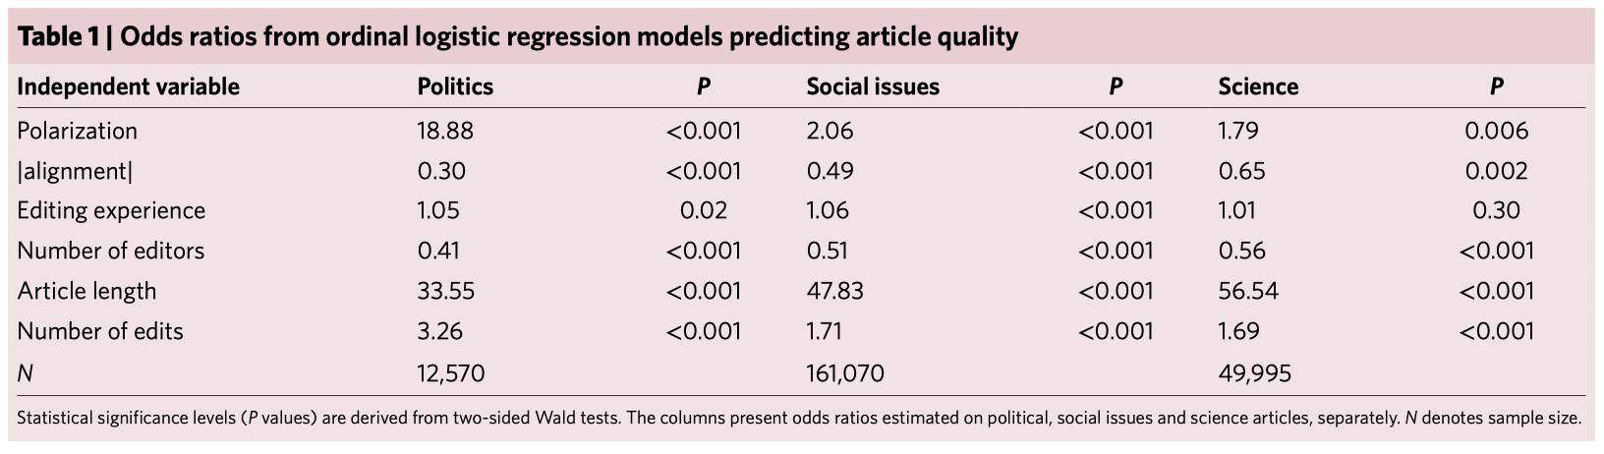
Power of polarized teams
Polarized teams consisting of ideologically diverse editors can produce articles of a higher quality than homogeneous teams.
The effect is more pronounced in Politics articles. Why?

Slide 39
Personalization & Recommendation
Building intelligent systems to recommend content, accounts, and products tailored to individual users.
User segmentation: dividing users into groups based on their demographics, behavior, or preference for marketing strategy.
Content-based filtering: match content to user interests.
Collaborative filtering: user-user & item-item similarities.
Find users similar to you (e.g., via Pearson correlation or cosine on rating vectors). Recomm. what those users liked & you haven’t seen.
Compute item-to-item similarity (based on features). For a user who liked A, recommend similar items B, C, etc.

Slide 40
User segmentation
Linguistic methods:
Cluster users based on their linguistic features
BoW, TF-IDF, LIWC, LDA, etc.
Obtain user embeddings based on post vectors
Network-based methods:
Node2vec: do random walks on social networks and train the word2vec model on the sampled trajectories of users (words).

Slide 41
Course notes
HW2 released
Due on Nov 14.
Social network analysis next week
Will use Team-Based Learning (TBL) setting
New location: CIC G-001 (map)
Watch AI-made lecture before class:
Canvas -> SDSC3013 -> Panopto Recordings
-> Social Network Centrality Measure
In-class group-based exercises (not graded)
Will take our second attendance checking!

